Slide 1

Heredity and Evolution
Mendel’s experiment

Slide 2

Let’s study Mendel’s Experiments With pea plant in detail

Slide 3
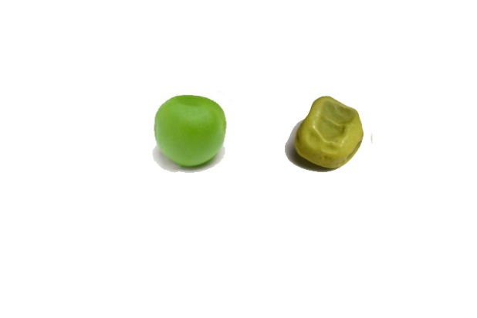
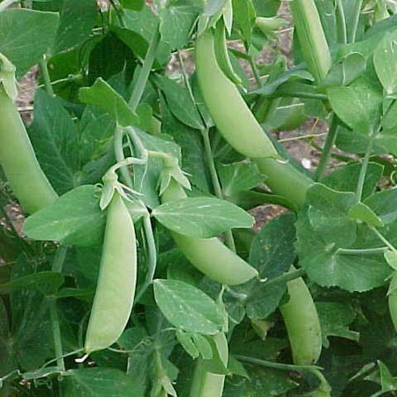
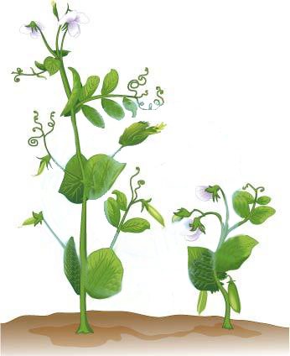
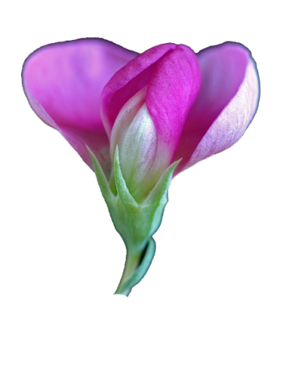
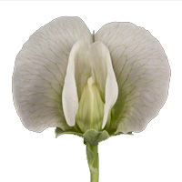
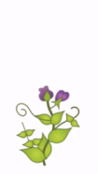
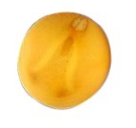
MENDEL’S EXPERIMENT
Seed shape
Mendel used Visible 7 contrasting characters of
Pisum Sativum (garden pea)
Round/Wrinkled
Height of plant
Colour of flower
7 contrasting characters are
Purple/White
Seed colour
Tall/dwarf
Yellow/Green

Slide 4
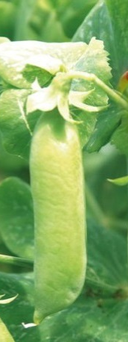

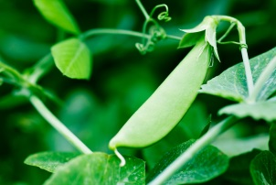
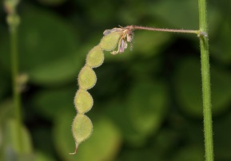
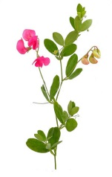
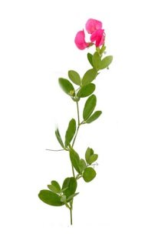
MENDEL’S EXPERIMENT
Pod colour
Pod shape
7 contrasting characters are
Full/Constricted
Position of flower
Green/Yellow
Axial/Terminal

Slide 5

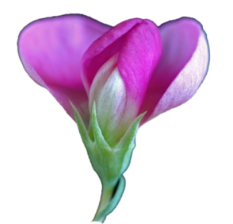

MENDEL’S EXPERIMENT
What he was thinking to do with these traits?
Producing offspring
by crossing these traits
As mendel has taken one character at a time, so it is called as mono hybrid cross
Calculate the percentage of the offspring with particular traits
Mendel made several crosses of pea plant
involving only one pair of character(traits)
For eg.
Tall plant
Dwarf plant
only one pair at a time
Mono means one
Hybrid means two different characters
First parents for crossing
P1 GENERATION

Slide 6
Thank You

